Slide 1
DEFAULT ON LOANS
CASE STUDY

Slide 2
Problem Statement
‘The client, a financial service institution, want to increase revenue streams and intents to target a segment of their customers who are most likely to default on the loans/Credit taken.
We try to solve this problem using Logistic Regression Model.

Slide 3
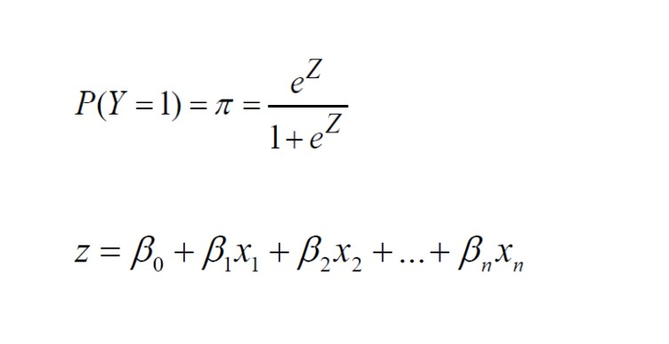
Logistic Regression
Logistic Regression is a supervised classification technique which is used to predict the probability of the Dependent Variable(Categorical in nature) given the independent variables
The name logistic regression emerges from logistic function.
Mathematically, logistic regression attempts to estimate conditional probability of an event
Z takes the form of Linear Regression equation.
Bn are coefficients
Xn are independent variables
P tells us the probability of an event to occur or not

Slide 4
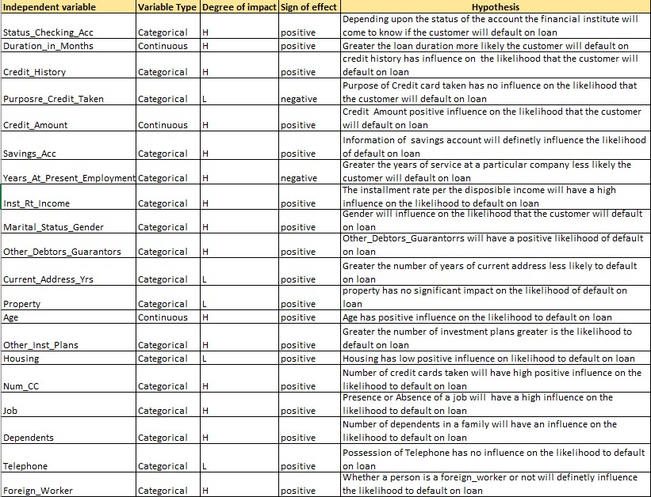
Hypothesis Table

Slide 5
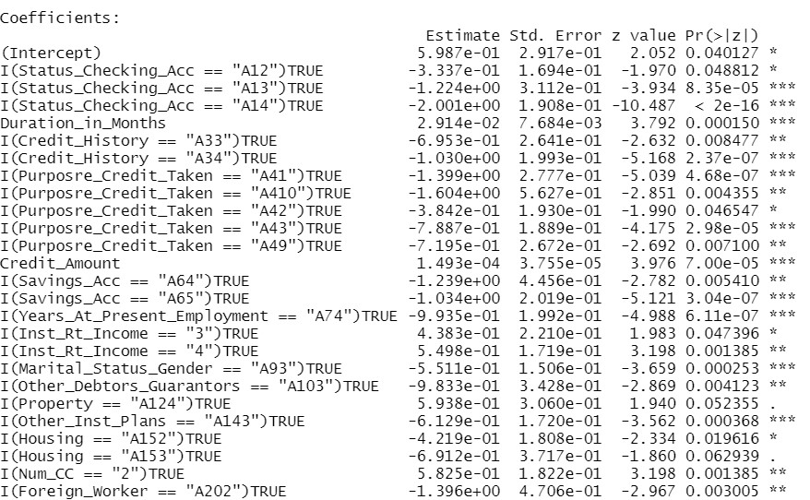
Final Model-Independent Variables and corresponding p-value

Slide 6
Final Model –Statistical Summary
All the independent variables are significant at 0.01(p=value)
Chi-squared test:X2 = 258.4, df = 15, P(> X2) = 0.0
Since p-value is less we reject the Ho null hypothesis that all Bi=0
Lagrange Multiplier Assumptions:
Ho=Final model=Baseline model
<A Baseline Model is model of random chance, and it does not contain any regressors>
Ha=Final model<> baseline model
From the model p value is 0.00,hence we reject Ho i.e is null hypothesis and accept the alternate hypothesis that Final model is better than a baseline model
Lacfit Deviance test Assumptions:
Ho: Observed Frequencies/probabilities =Expected Frequencies/probabilities
From the model p value is 0.9974707 which is high
Thus, we accept the Null Hypothesis (Ho) that Observed Frequencies = Expected Frequencies

Slide 7
Final Model –Statistical Summary
The accuracy of the Confusion Matrix is 74%
Specificity of the model is 54.38336%
Sensitivity of the model is 89.96372 %
Recall of the model is 81.51448%
Precision of the model is 54.38336%
Area under the Roc Curve is 83.94%
Gini of the model is 0.6787872

Slide 8
Insights
All the model test statistics results fall under the acceptable range
Since the recall is high the model has been able to predict the likelihood of ‘1’ for the dependent variable default_on_loan accurately.
The top 5 dependent variables which will highly influence the probability to default_on_loan to be “1” are as follows:
(Status_Checking_Acc == "A14")
2. (Credit_History == "A34")
3. (Savings_Acc == "A65")
4. (Purposre_Credit_Taken == "A41")
5. (Years_At_Present_Employment == "A74")

